Slide 1
Have a professional looking broadcast on a minimal budget
Geoff Kruse
Gkruse@centrallyon.org
Central Lyon broadcasting on YouTube
https://bit.ly/2Tu01jv

Slide 2
What do we do?
Broadcast all events that occur in our gym, auditorium, football field & baseball field
Use students to help in the broadcast
  Run the "board"
  Announce
  Create content

Slide 3
How we got started
Laptop with not the greatest specs
USB microphone
Elgato HD Capture Card
Non HD camcorder

Slide 4
What do we use now
Open Broadcaster Software (OBS)
  Streaming program
Dell Laptop & Desktop
Canon Camcorders
iPad
Broadcast Mixer for Announcing
  Audio Technica headsets
NDI
YouTube Live

Slide 5
Our setups
Portable
Permanent
Dell Laptop
Camcorder
  Same one our coaches use
Elgato HD60 Capture Card
Used for football, baseball & in auditorium
Estimated cost is about $1000
Dell Desktop
Camcorders
  Same one our coaches use
  One in each corner of the gym
  iPad
Elgato HD60 Capture Card
Elgato HD60 Pro Internal Capture Card
Estimated cost is about $2500

Slide 6
extras
JK Audio Remotemix 4 with Audio Technica Headsets
  Can just be USB or can use a more professional setup
Scoreboard Integration
  Daktronics All-Sport CG
NewTek LiveText for graphics
  Standalone version if not using TriCaster
App for iPad
  NDIcam for $10
Elgato Streamdeck
  Make it easier to control OBS

Slide 7
Multi-camera setups
Requirements
  Either multiple cameras with Elgato cards or NDI capabilities
  Either HD60S or above Elgato cards or multiple laptops with Elgato
We have a combination
  Desktop with internal Elgato card and Elgato HD60 external card
  Laptop with Elgato HD60 connects to desktop using NDI

Slide 8
Open broadcaster software
https://obsproject.com/
FREE
Extremely diverse
Not a resource hog
Other software that is similar
  Xsplit
  Vmix
  Wirecast

Slide 9
Elgato stream deck
6 Key version is $70 or 15 key version is $150
Allows "remote" control of the computer
Program "buttons"
  Can have folders to do more than 15
Switch scenes, control volume, play media, use social media, etc....
Allows one person to do so much more!

Slide 10
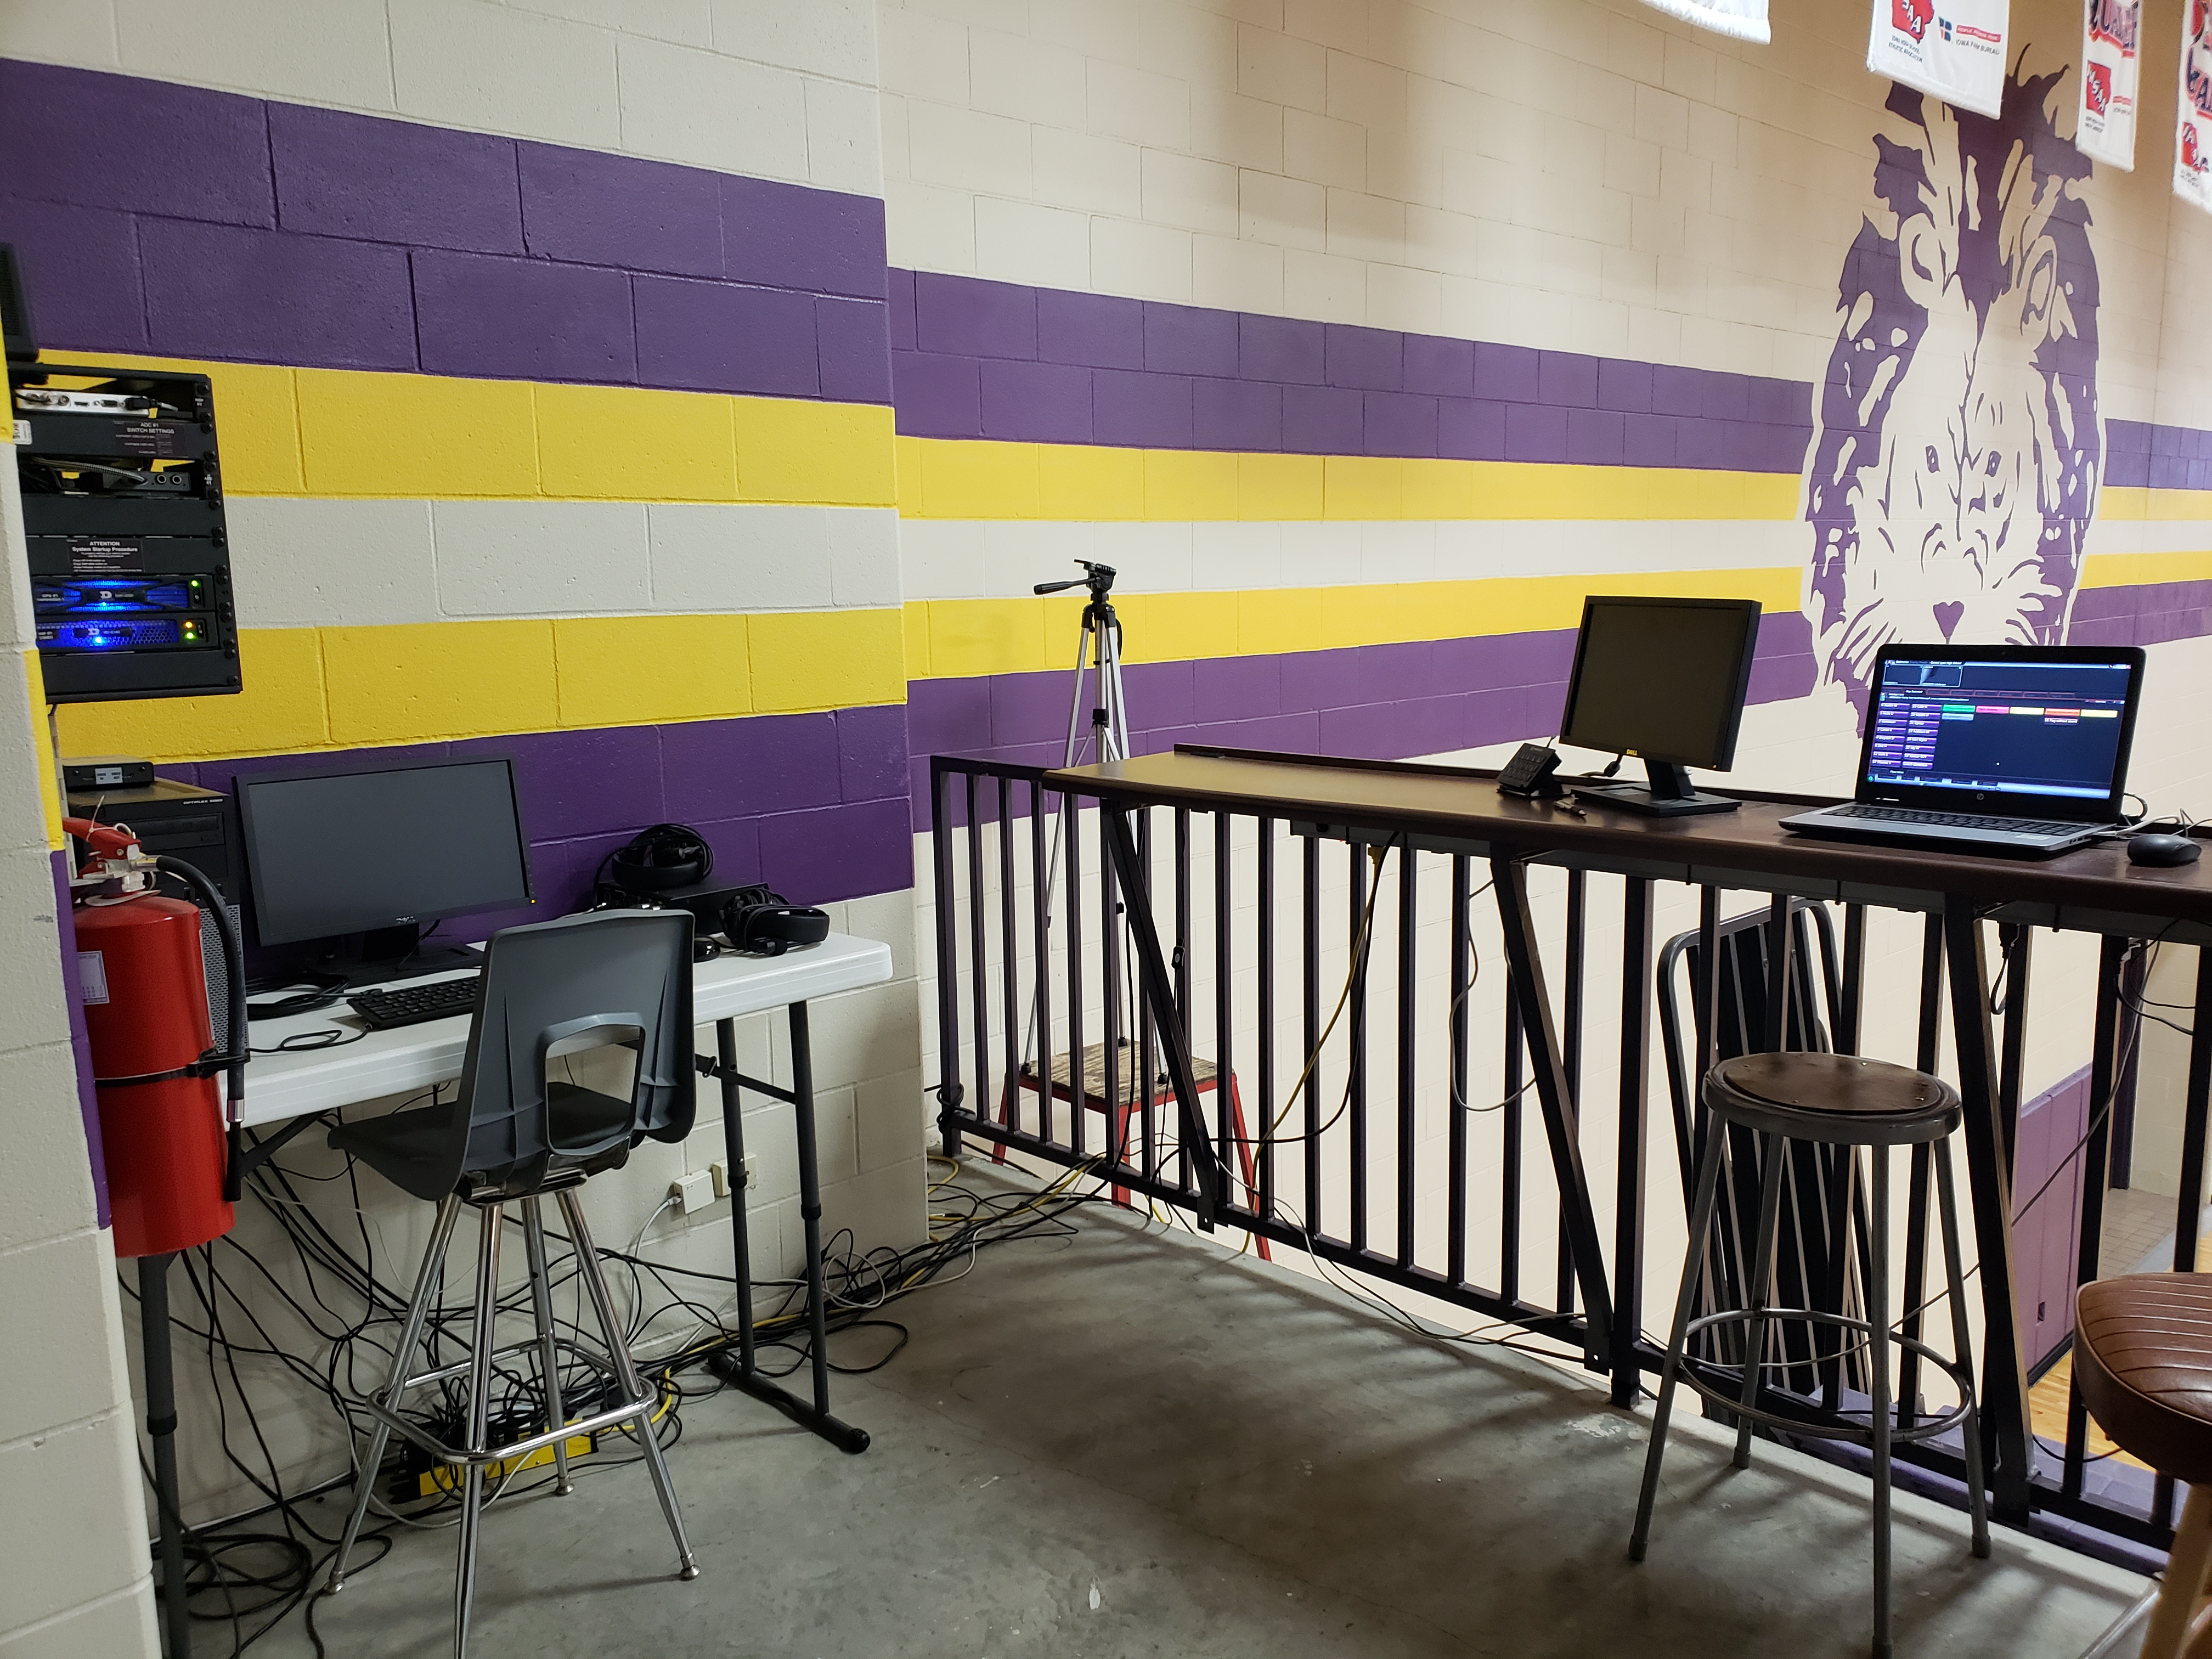
Our permanent system

Slide 11
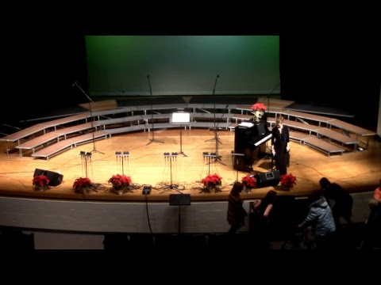
Examples – portable system in auditorium (480p)

Slide 12
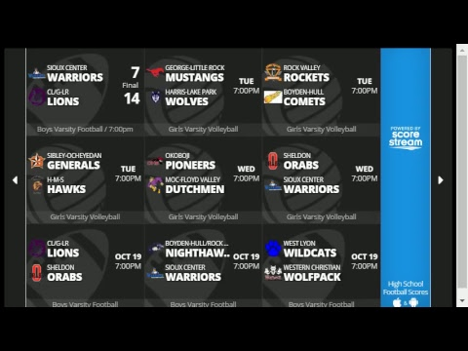
Examples – portable system at football field (480p)

Slide 13
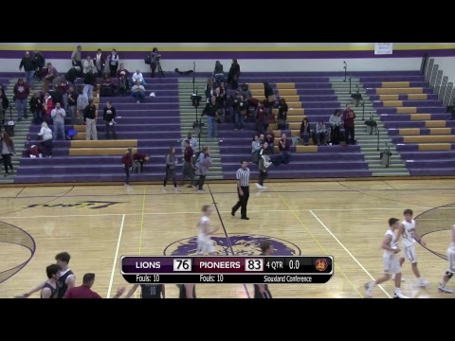
Examples – permanent system in gym (1080p)

